Slide 1



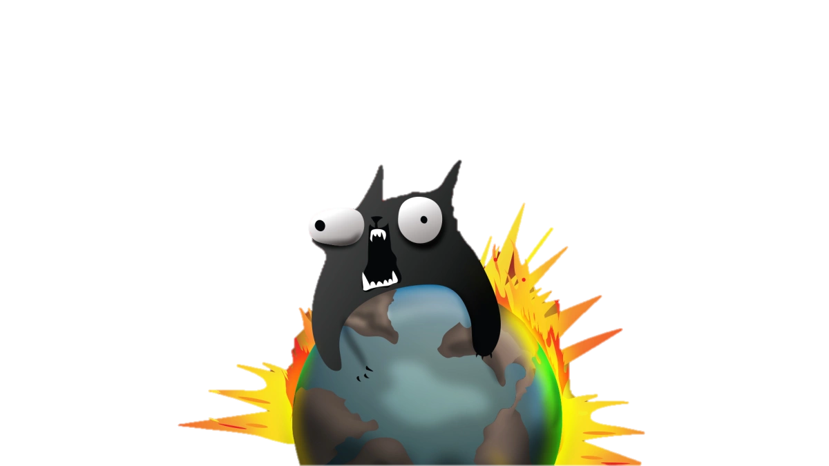

Slide 2

Whats the Game about?
Whoever explodes loses
Who doesn’t explode, wins
All other cards reduce the chance to explode by exploding kittens.
Explode by pulling an exploding kittens
Survive by luck and defuse cards
Other Cards:
look into the future
suspend a turn
attack fellow players
draw from the bottom
steal cards from an opponent
reshuffle
...

Slide 3
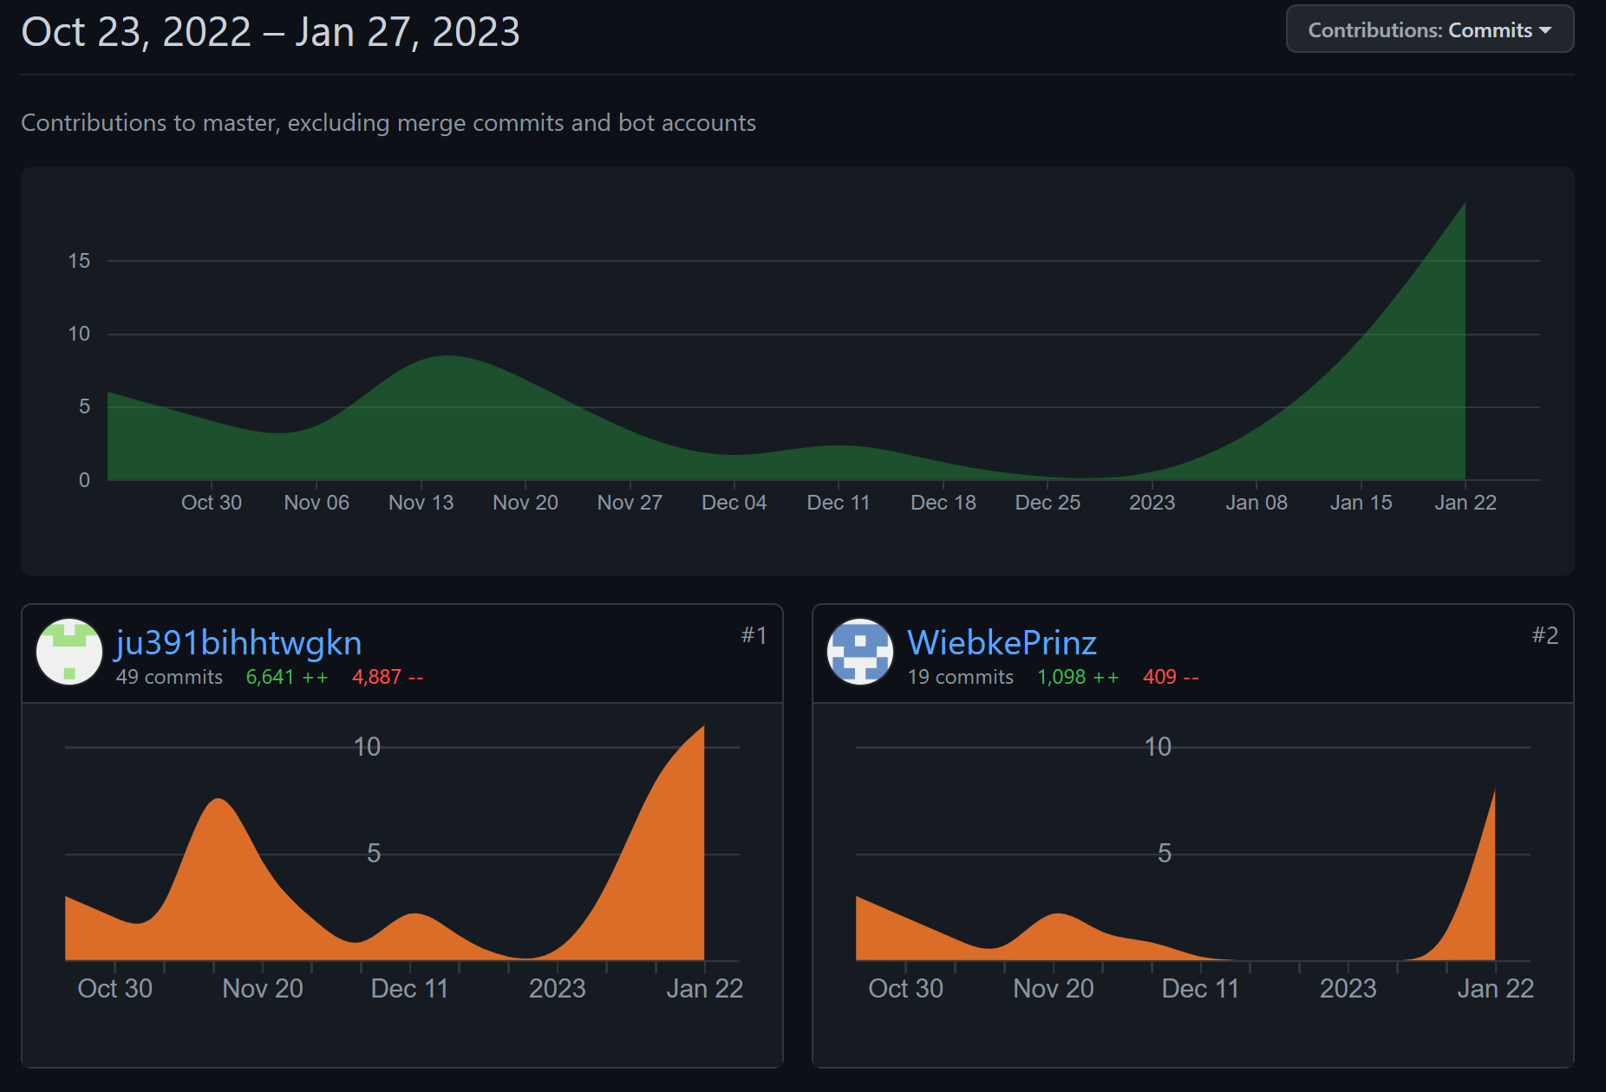
Git and Github

Slide 4
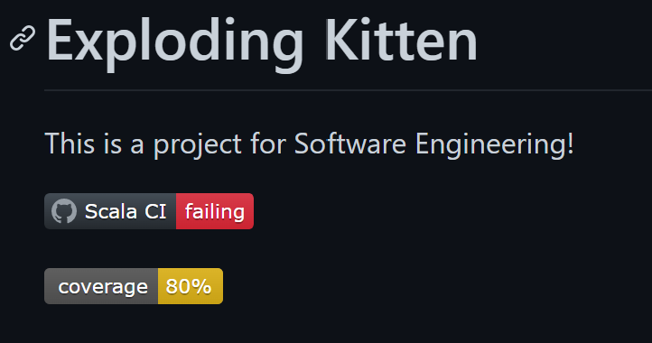
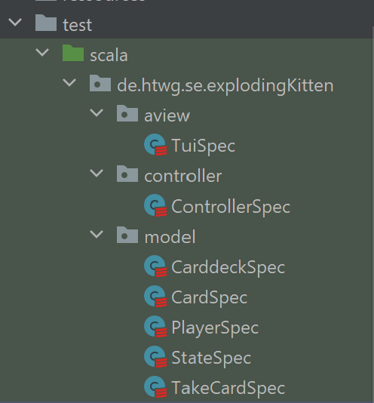
Coverage Reports

Slide 5
Text User Interface

Slide 6
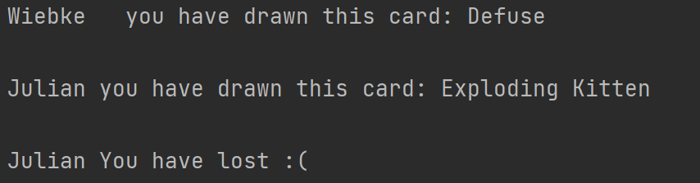
Take Card
def processInputLine(): Unit = { while (controller.flag == true) { println("Your turn " + controller.gameState.players(controller.gameState.currentPlayer).name) println(controller.gameState.players(controller.gameState.currentPlayer).handCards.toString()) val input = readLine() input match { case "t" => { if(controller.gameState.deck.head.cardName == "Exploding Kitten") { println("You have drawn a Exploding Kitten") println("Choose a place to put it into the deck!") context.setStrategy(new TakeExploding(readLine().toInt)) context.executeStrategy(controller) context.setStrategy(new NextPlayer()) context.executeStrategy(controller) } else { // Take a Card context.setStrategy(new TakeCard()) context.executeStrategy(controller) // Next Player context.setStrategy(new NextPlayer()) context.executeStrategy(controller) } }

Slide 7
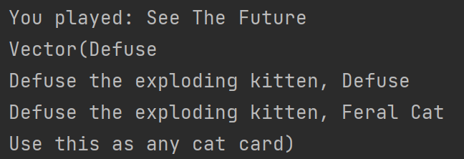
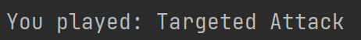
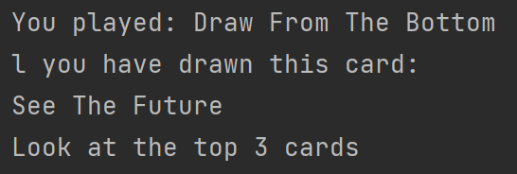
Play Card
case "p" => // Play a Card println("Which Card do you want to play ? Please enter the Number of the Card") val input = readLine().toInt val cardType = controller.gameState.players(controller.gameState.currentPlayer).handCards(input).actionCode cardType match { case 1 => context.setStrategy(new DrawFromTheBottom(input)) context.executeStrategy(controller) case 2 => context.setStrategy(new SeeTheFuture(input)) context.executeStrategy(controller) case 3 => context.setStrategy(new Skip(input)) context.executeStrategy(controller) case 4 => context.setStrategy(new Attack(input)) case 5 => println("Choose a Player to Attack") context.setStrategy(new TargetedAttack(input, readLine().toInt)) context.executeStrategy(controller) case 14 => context.setStrategy(new Shuffle(input)) context.executeStrategy(controller) }

Slide 8
Undo/Redo and Save/Load
case "r" => controller.redo() case "u" => controller.undo()
case "s" => controller.save() case "l" => controller.load() } } } override def update: Unit = controller.gameState

Slide 9
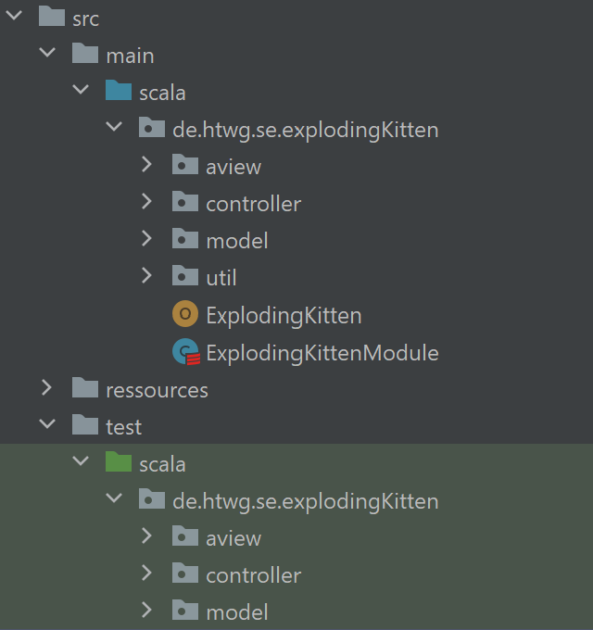
MVC Architecture

Slide 10
Design Pattern

Slide 11
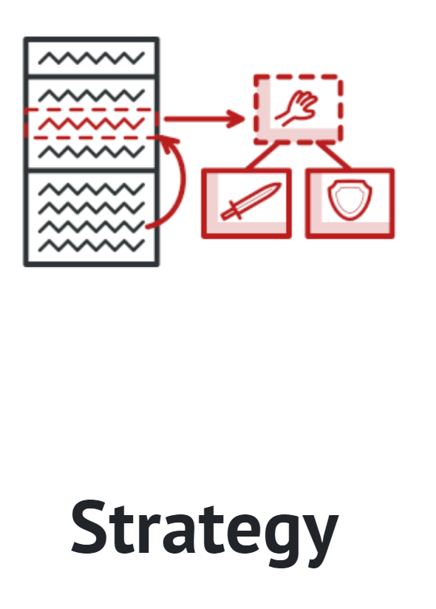
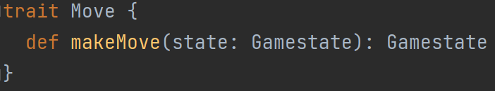
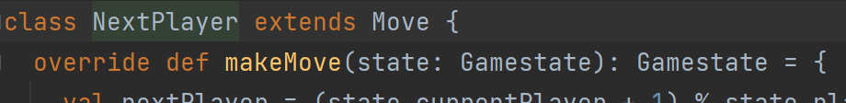
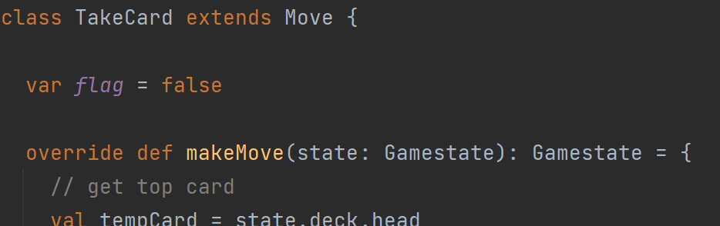
Strategy – Java Style
Context
<<interface>>
Strategy
+execute()
class SeeTheFuture(i: Int) extends Move { var flag = false override def makeMove(state: Gamestate): Gamestate = { val currentPlayer = state.currentPlayer val card = state.players(currentPlayer).handCards(i) println("You played: " + card.cardName) val newDiscardPile = state.discardPile.appended(card) val newHandCards = state.players(currentPlayer).playCard(card) val newPlayer = state.players.updated(currentPlayer, Player(state.players(currentPlayer).name, newHandCards)) val newState = state.copy(players = newPlayer, discardPile = newDiscardPile) if (newState.deck.length > 2) { val topCards = newState.deck.take(3) println(topCards) newState } else { val topCards = newState.deck.take(newState.deck.length) println(topCards) newState } } }
ConcreteStrategyA
ConcreteStrategyB
+execute()
+execute()

Slide 12
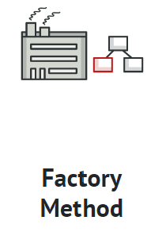
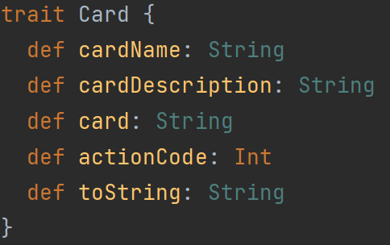
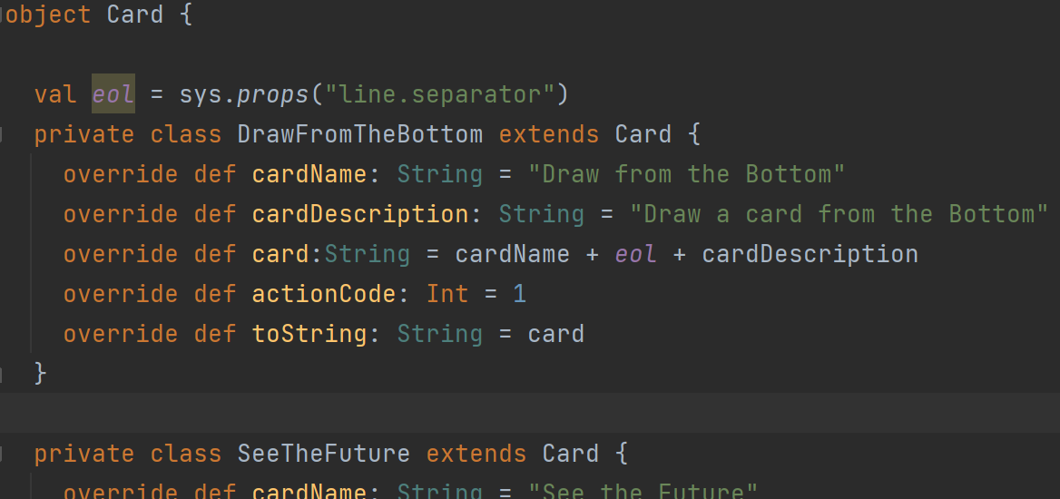
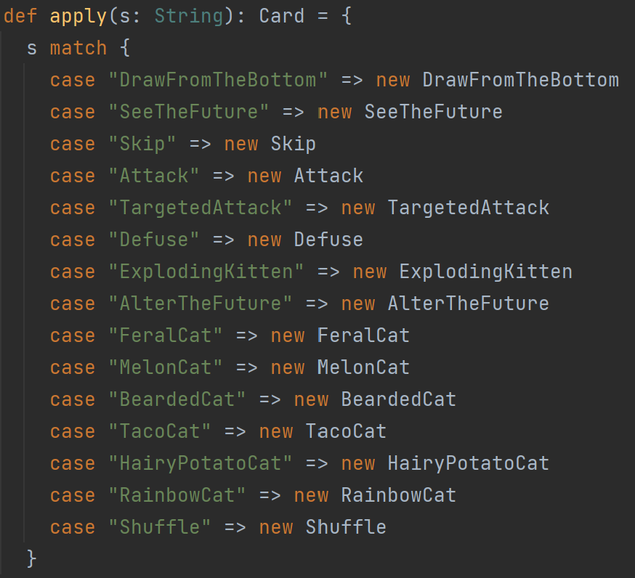
Factory
<<interface>>
Product
Creato
+factoryMethod()
+anOperation()
ConcreteCreator
ConcreteProduct
+factoryMethod()

Slide 13
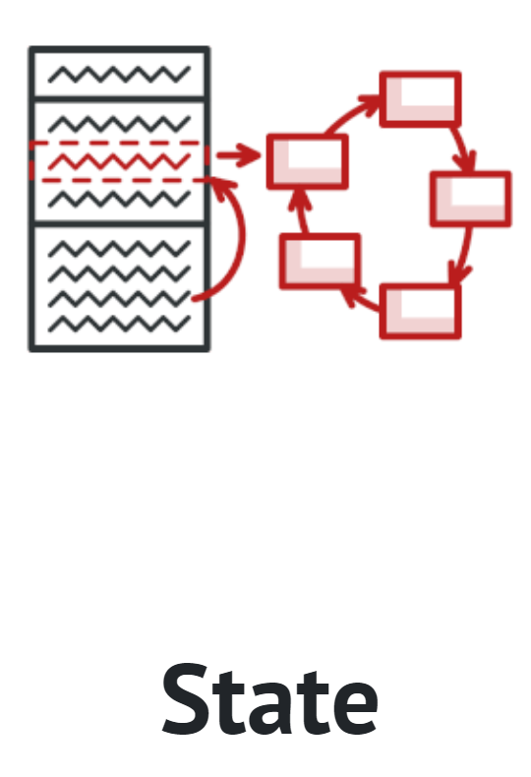
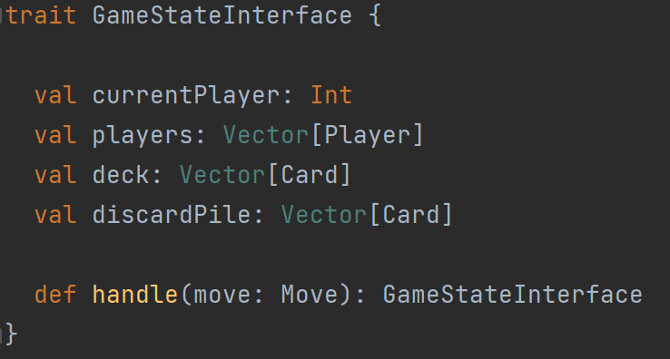
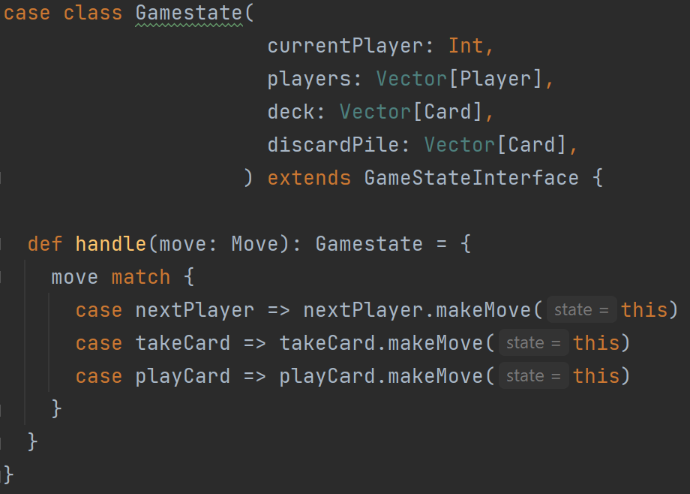
State
Context
<<interface>>
State
+request()
+handle()
ConcreteStateA
ConcreteStateB
+handle()
+handle()

Slide 14
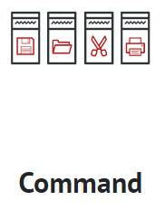
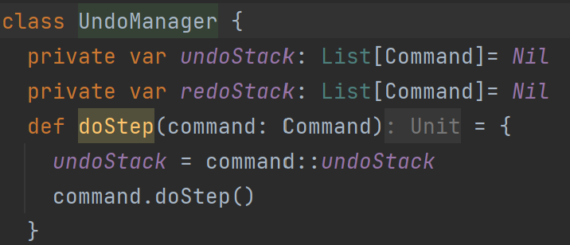
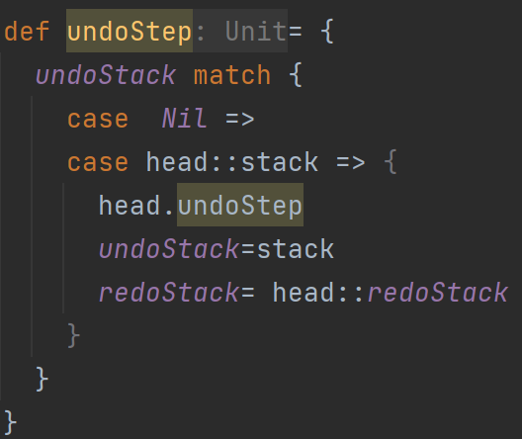
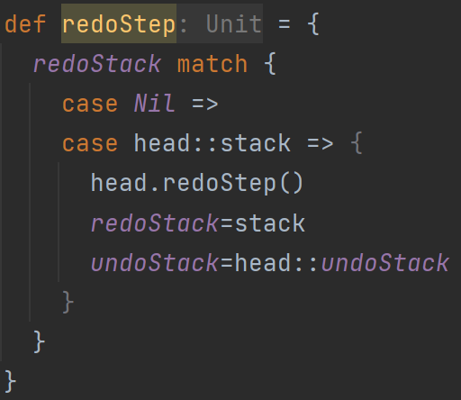
Undo
Client
Invoker
Command
+execute()
Receiver
ConcreteCommand
+execute()

Slide 15
GUI

Slide 16
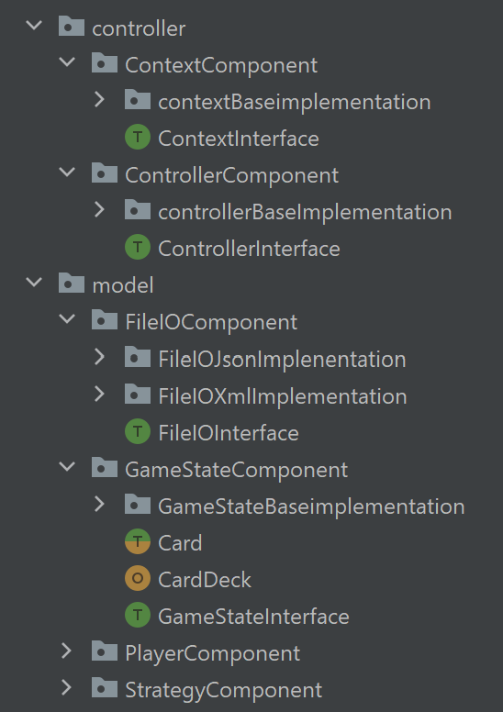
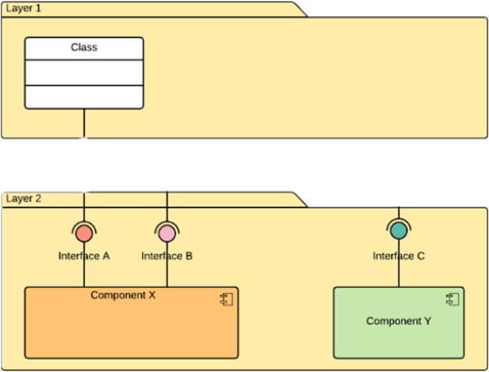
Components

Slide 17
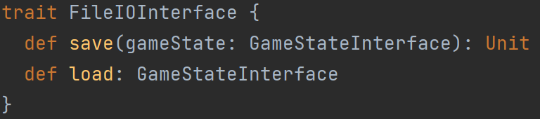
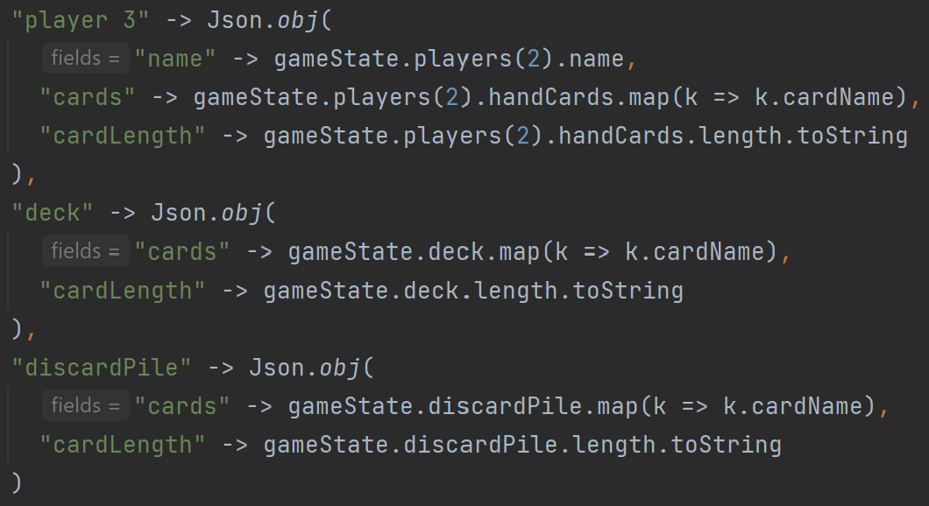
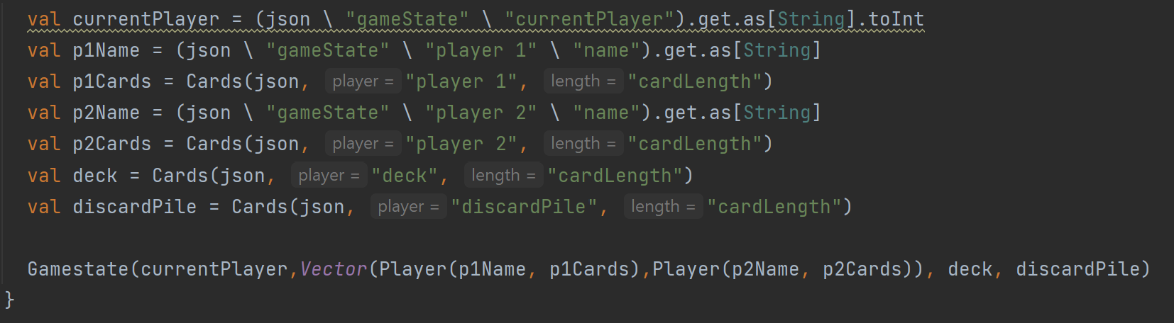
File I/O JSON
Save()
Load()

Slide 18
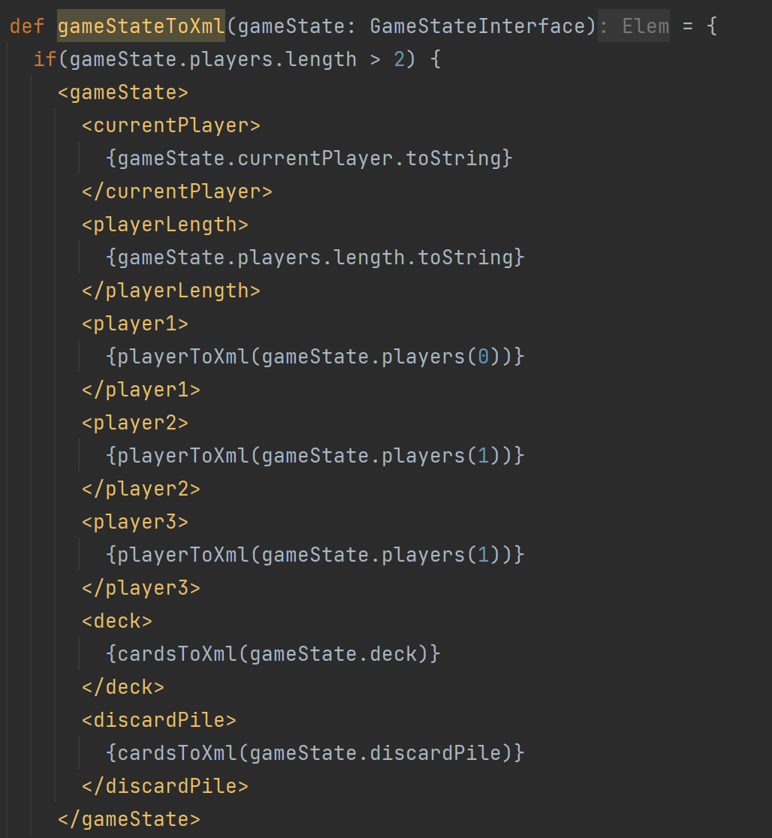
File I/O XML
def playerToXml(player: Player) = { <player> <name>{player.name} </name> <cards>{player.handCards.map(k => k.cardName + ",")} </cards> <cardLength>{player.handCards.length.toString} </cardLength> </player> } def cardsToXml(cards: Vector[Card]) = { <cards>{cards.map(k => k.cardName + ",")} </cards> }

Slide 19
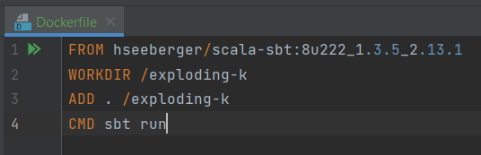
Docker

Slide 20
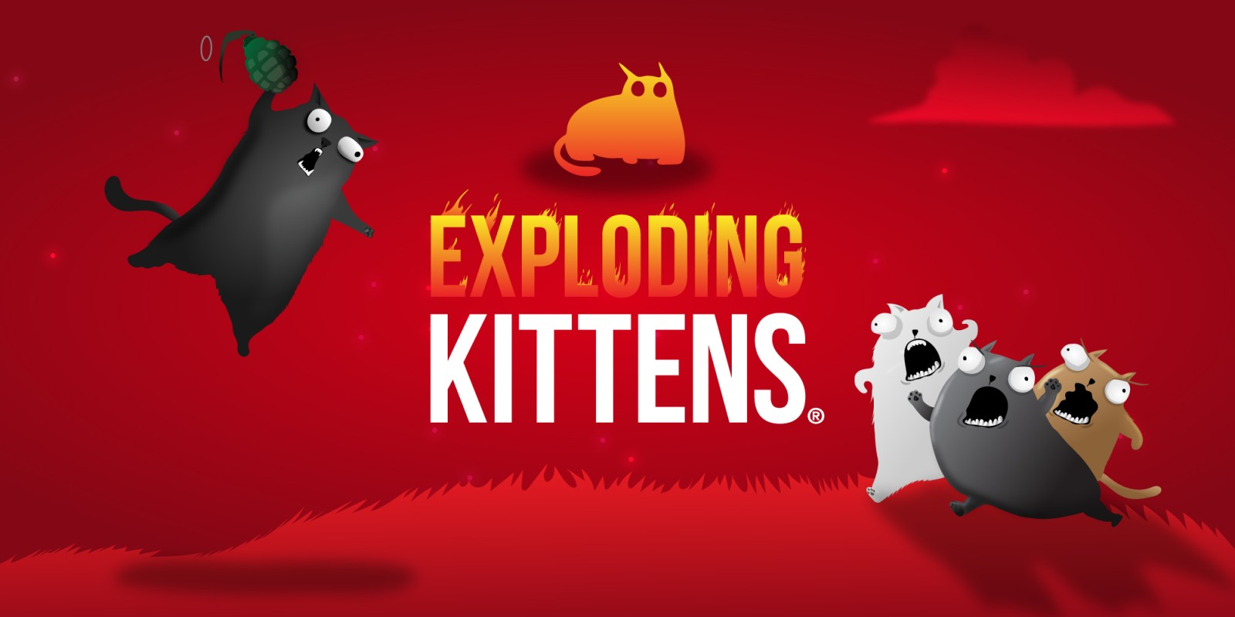
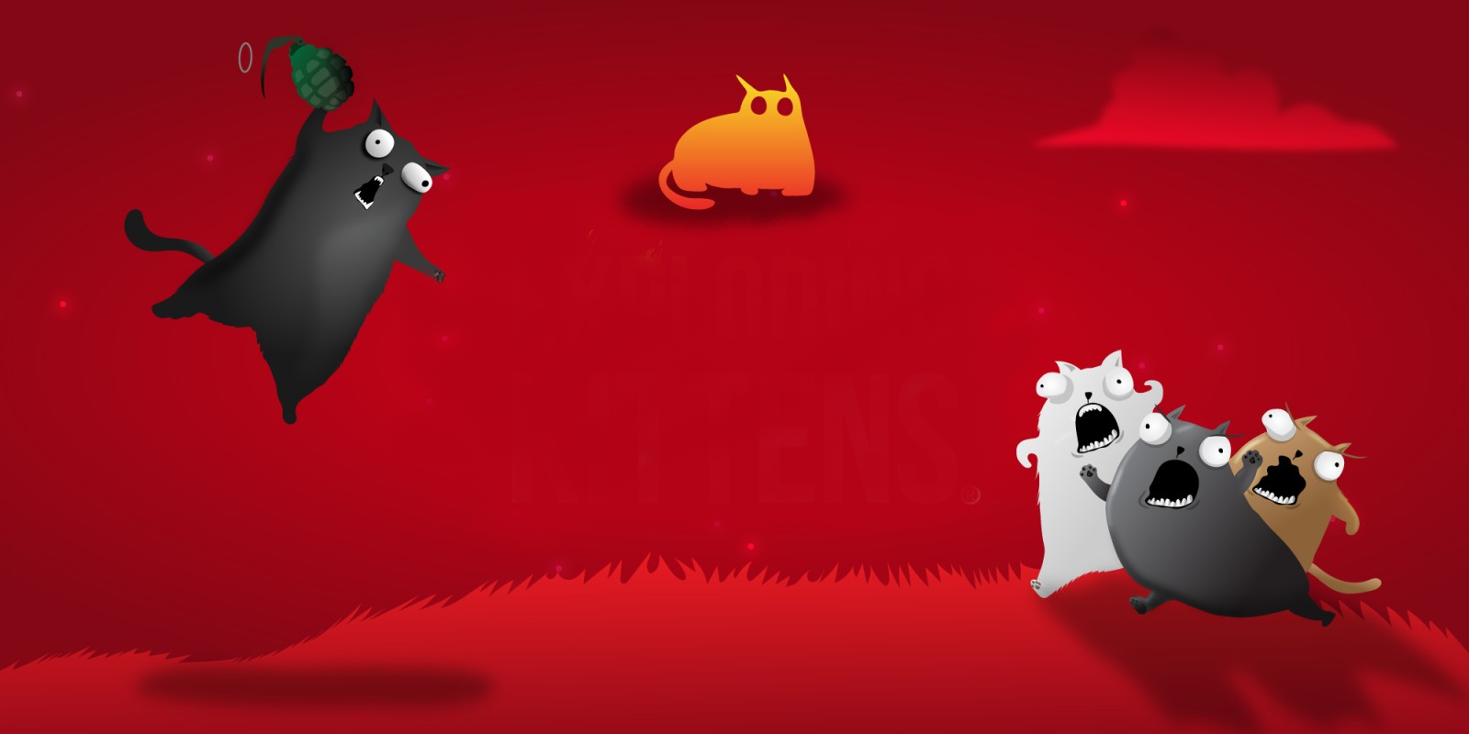
Thank you for your attention!

